Slide 1
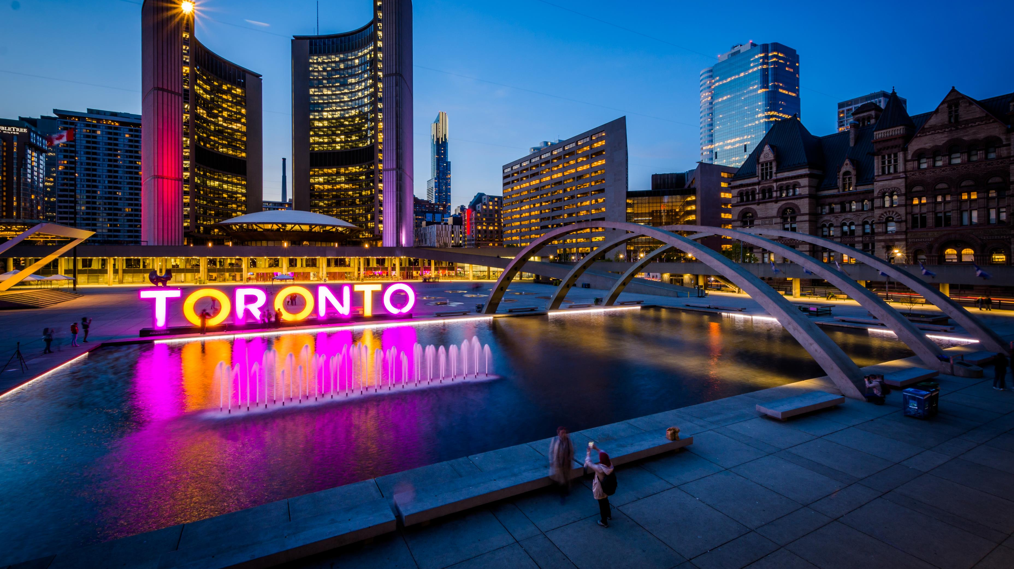
Theodore Kim
Sustainable Transportation
Notes:
http://completestreetsforcanada.ca/examples/downtown-yonge-street-toronto-ontario

Slide 2
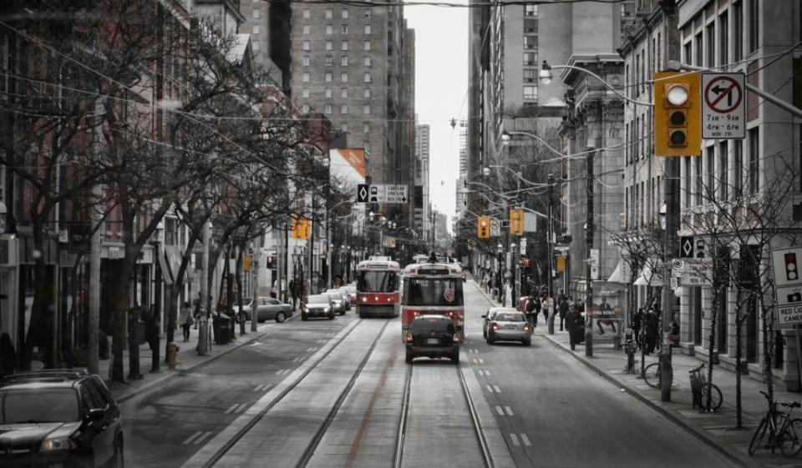
STREET DESIGN

Slide 3
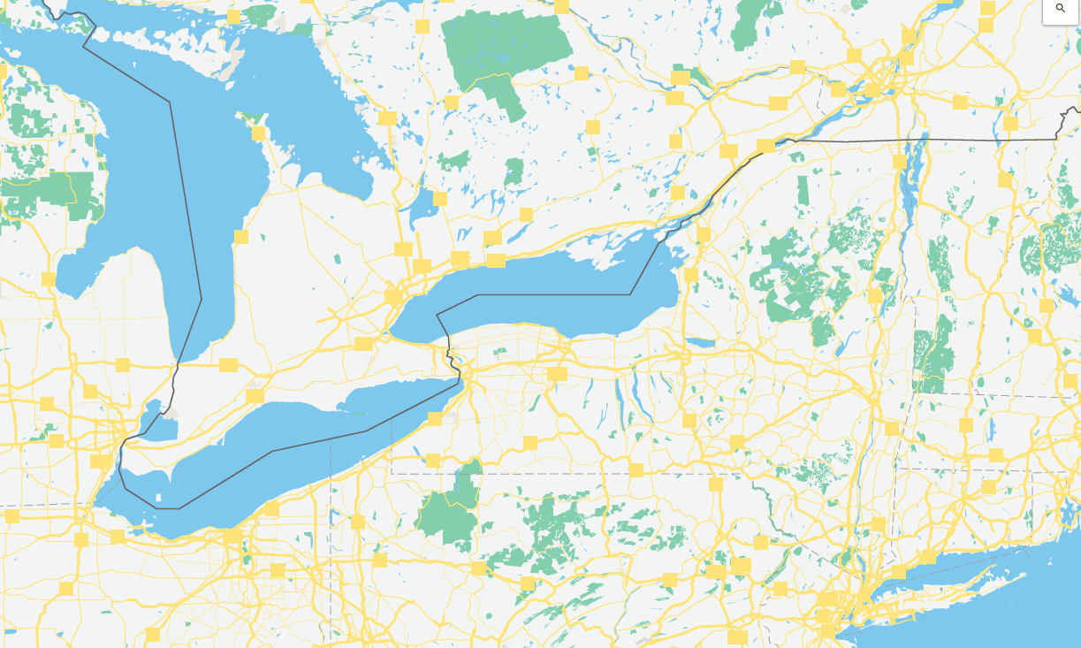


OTTAWA
TORONTO
POPULATION: 2.809 million (largest city in Canada)
AREA: 243.3 sq. miles
TRANSPORTATION OPTIONS: subway, streetcars, buses, commuter rail and private cars
TORONTO is the only Canadian city with representation in seven major league sports
NEW YORK
Notes:
, streetcarsNYC area is 304.6 miles
NYC population is 8.538 million people
Toronto Transportation Commission
Largest streetcar system in the world

Slide 4
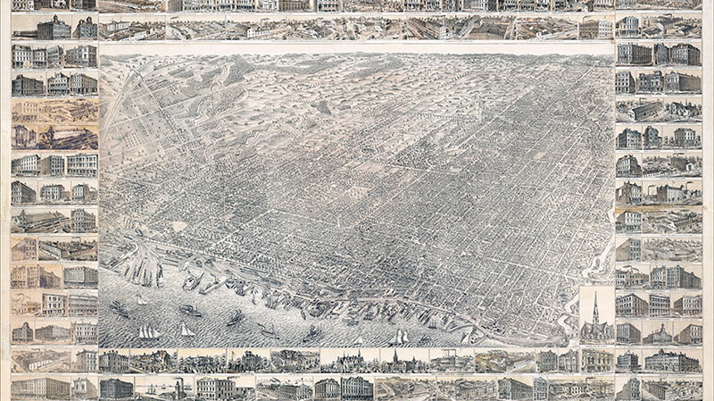
The Historical Development of Toronto

Slide 5
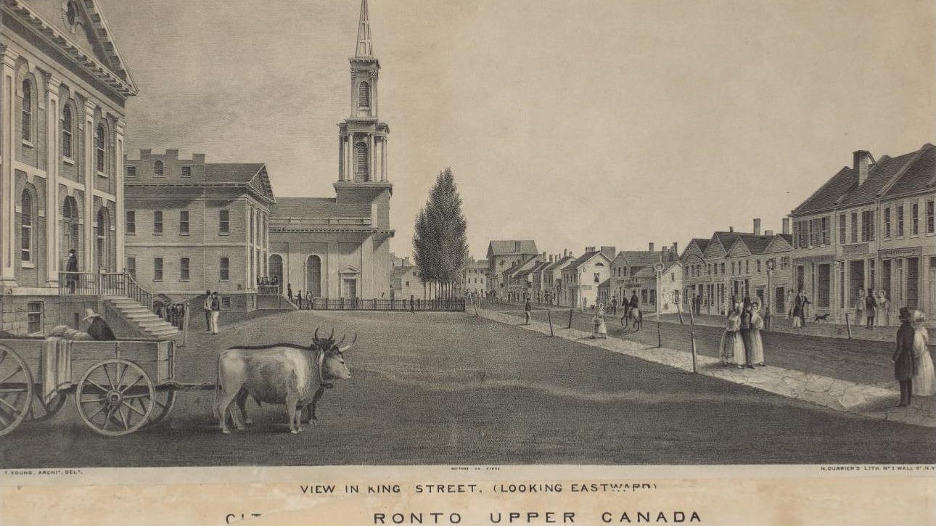
King St and Yonge St
c.1810, looking east

Slide 6
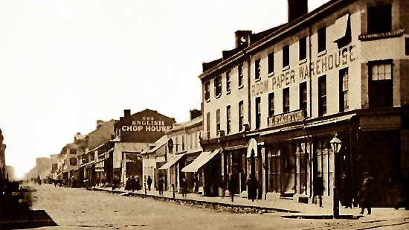
King St and Yonge St
1868, looking north

Slide 7
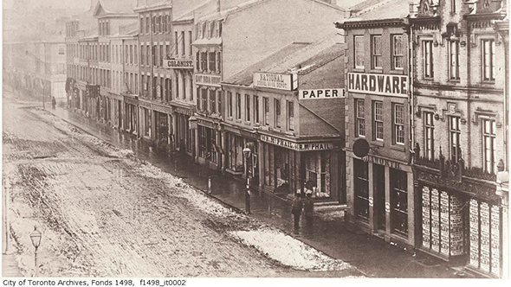
King St and Yonge St
1895, looking east

Slide 8
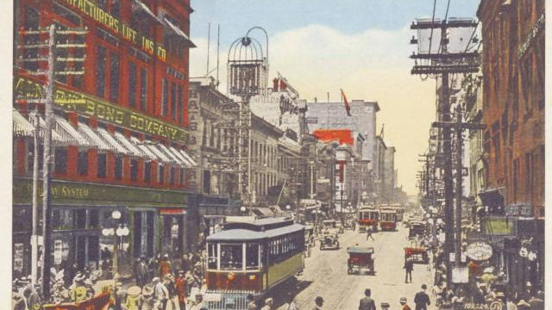
King St and Yonge St
1910, looking east

Slide 9
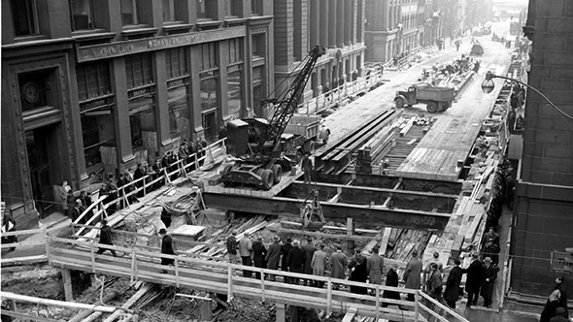
King St and Yonge St
1950, looking south

Slide 10
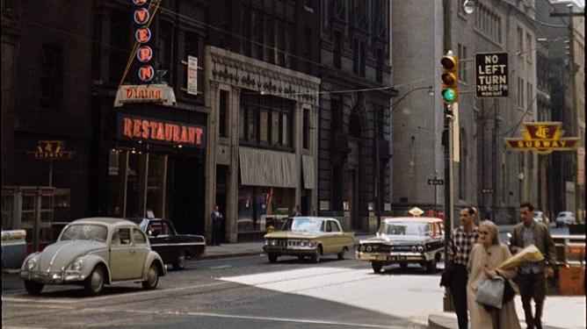
King St and Yonge St
1971, looking west

Slide 11
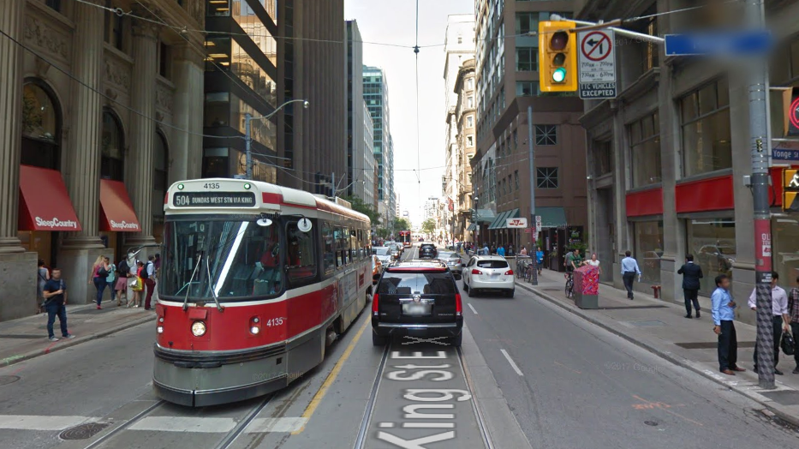
King St and Yonge St
2017, looking east

Slide 12
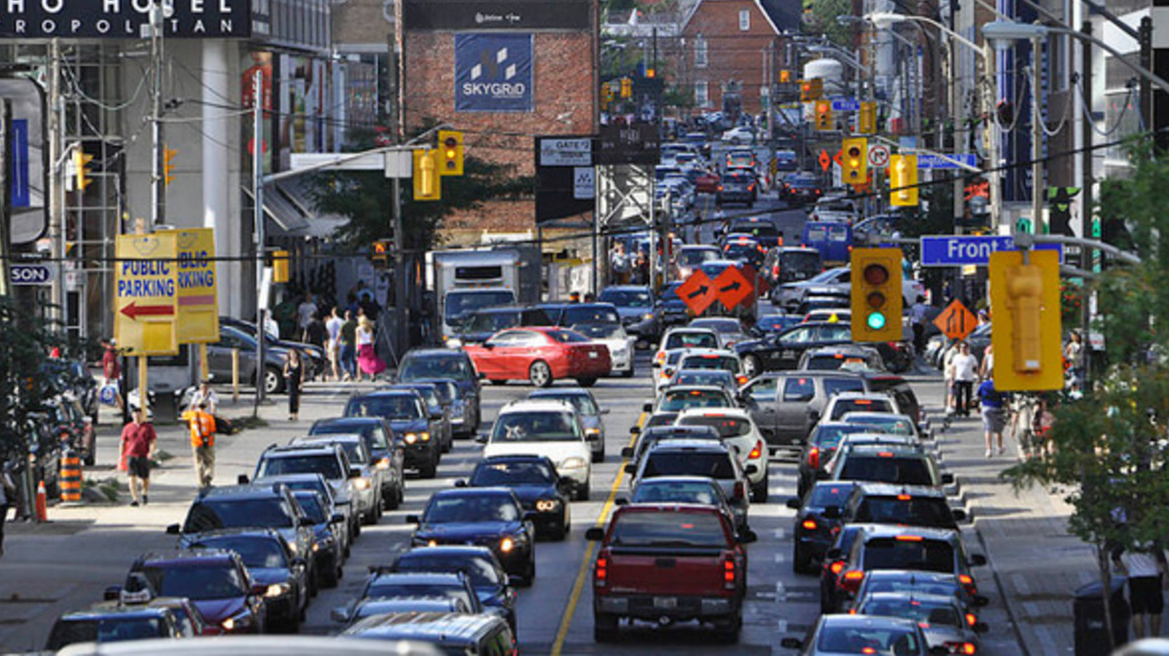
Challenges to Sustainable Street Design

Slide 13
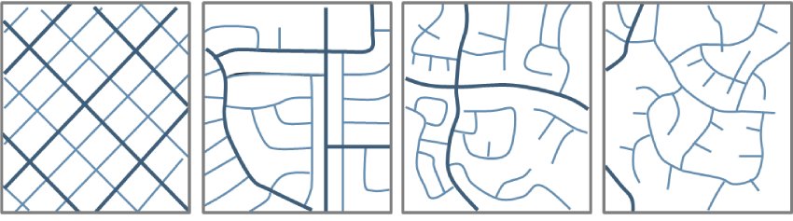
Street Layout: The patterns by which streets are laid out as a part of sustainable development

Slide 15
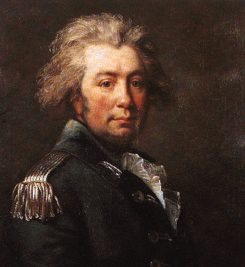
JOHN GRAVES SIMCOE founded the colony of York as the capital of Upper Canada (present day Ontario) in 1793 and was the first to lay out plans for the city

Slide 16
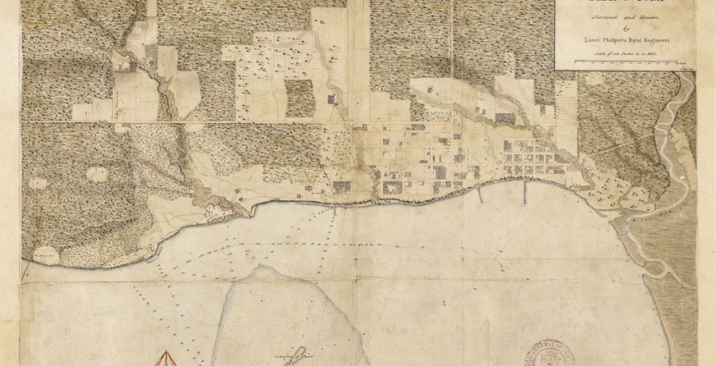

1818 Phillpotts Plan of York

Slide 17
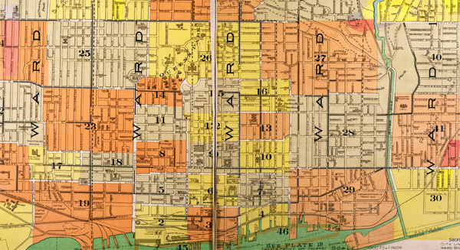

Slide 18
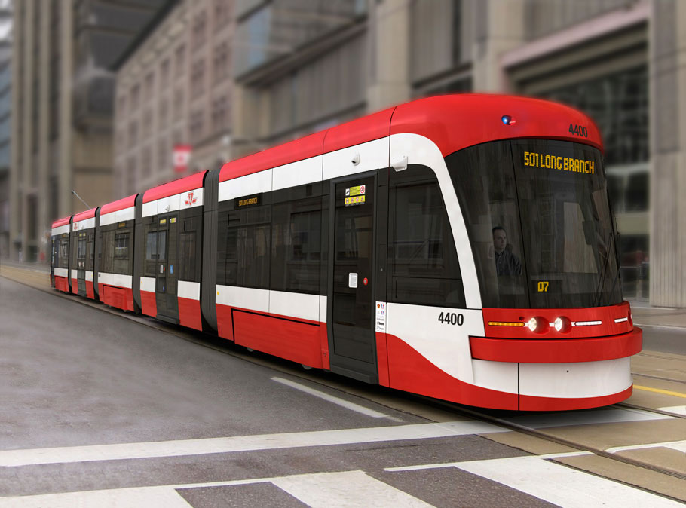

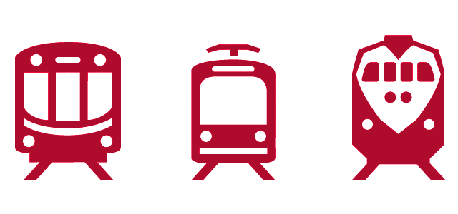
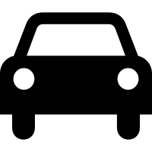

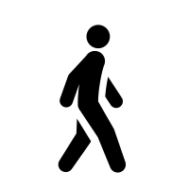
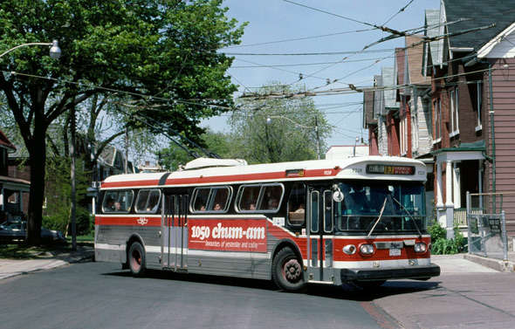
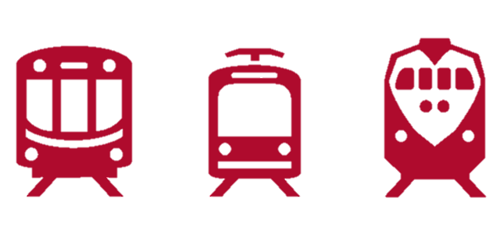
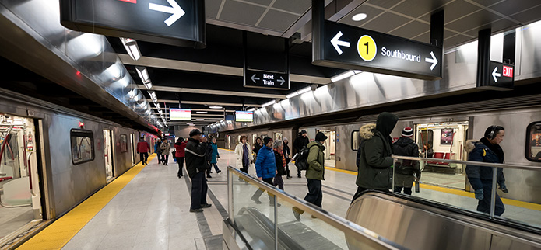
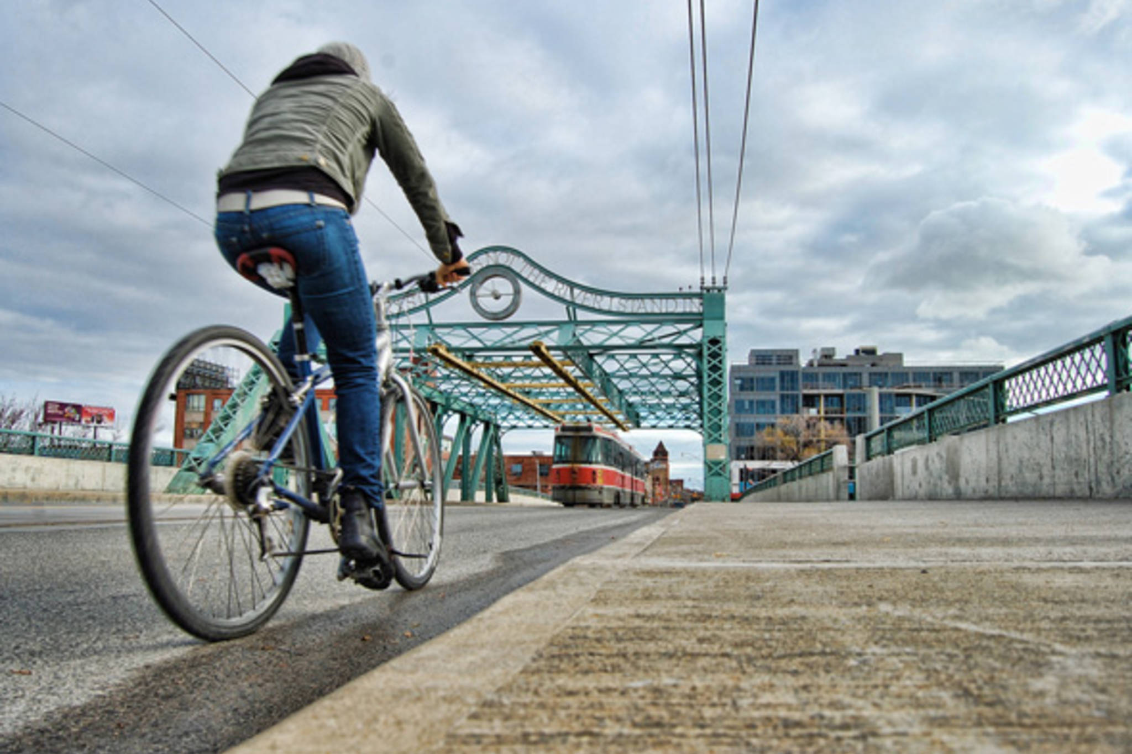
Toronto has the largest light rail system in the Americas with a daily ridership of 300,000
Toronto has 141 bus routes covering the entire Metropolitan are, including BRT
With 75 (+22) stations and 4 (+1) lines, the Toronto subway sees a 1 million daily riders
Toronto has a 3.5% daily cycling rate, compared to the Canadian average of 3.2%

Slide 19
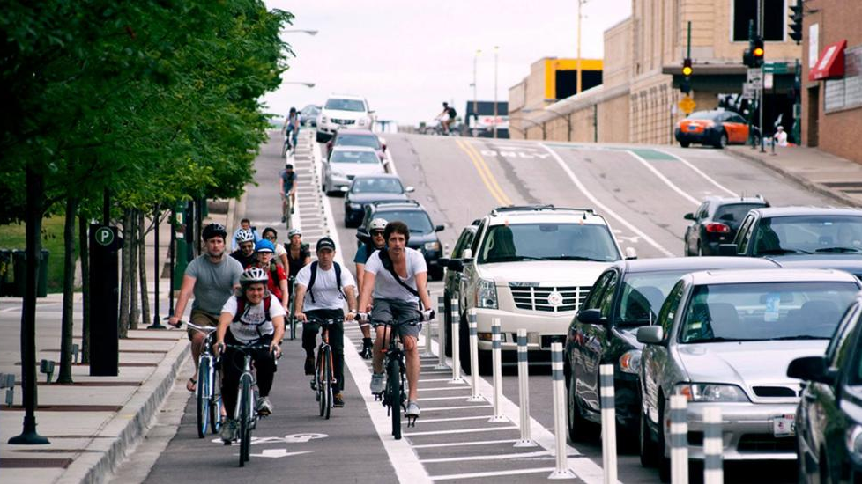
Sustainable Street Design and Development

Slide 20
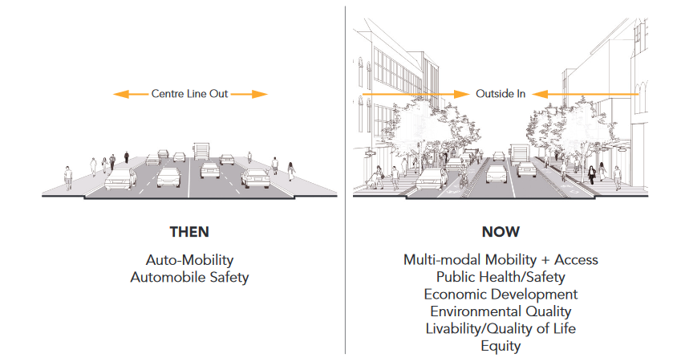
COMPLETE STREETS “Planning streets for all users and uses”

Slide 21

Complete Streets Overview https://www.youtube.com/watch?v=5U1m-vQwY1s

Slide 22
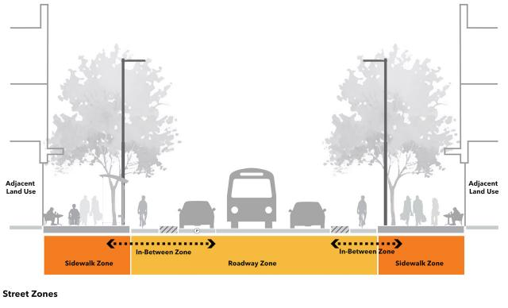

Slide 23
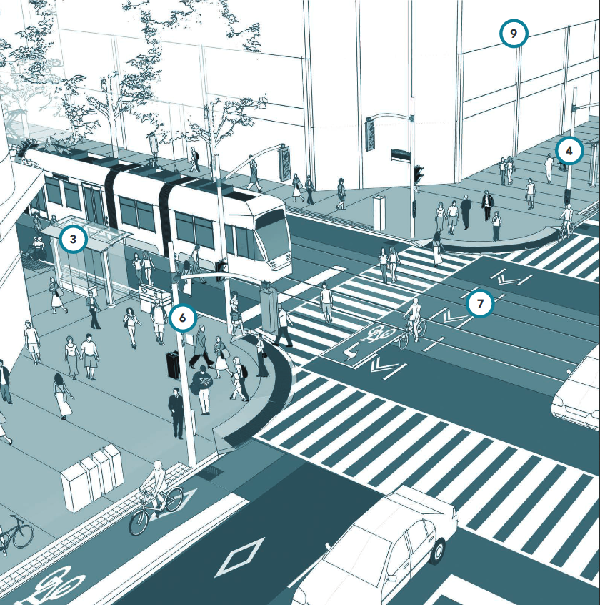
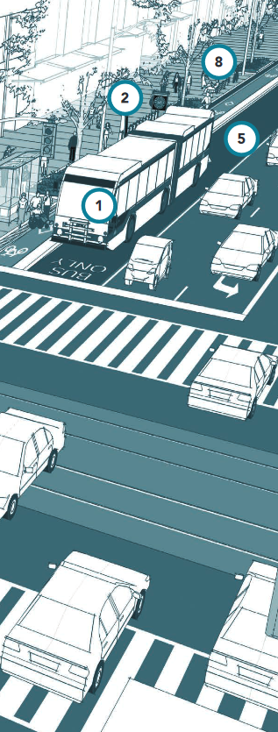
1
Dedicated Bus Lanes
2
“Green” coverage
3
Safe and comfortable transit stop
4
Wide sidewalks for future expansion
5
Dedicated bus queuing lanes
6
Effective traffic signaling
7
Safe cross modal crossings
8
Shielded cycling lanes
9
Reduced building development boundaries

Slide 24
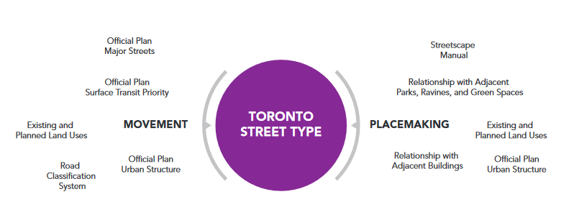

Slide 25
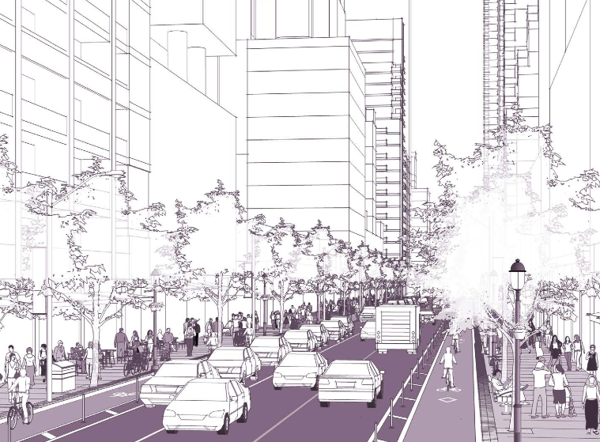
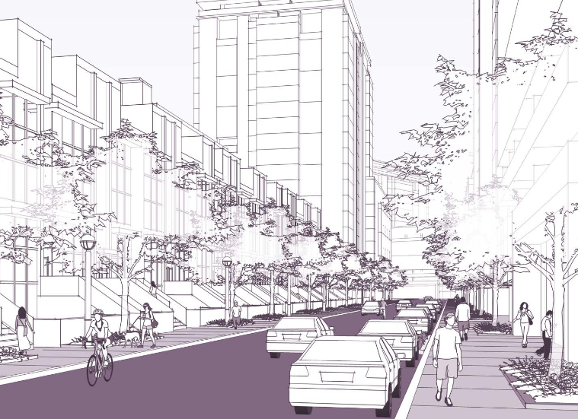
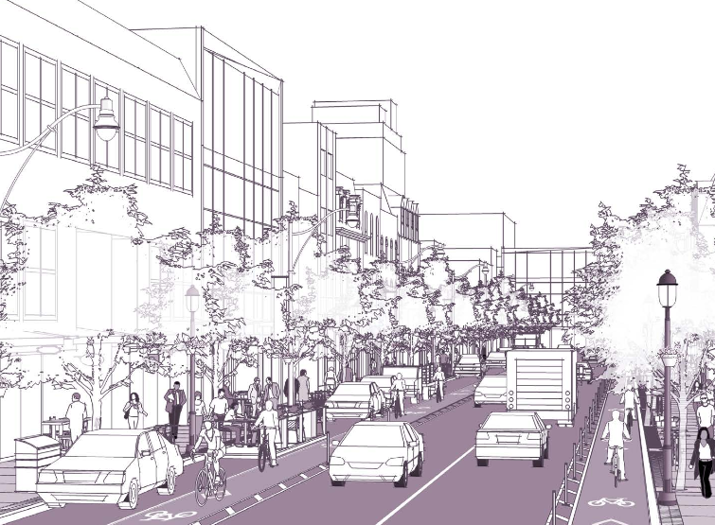
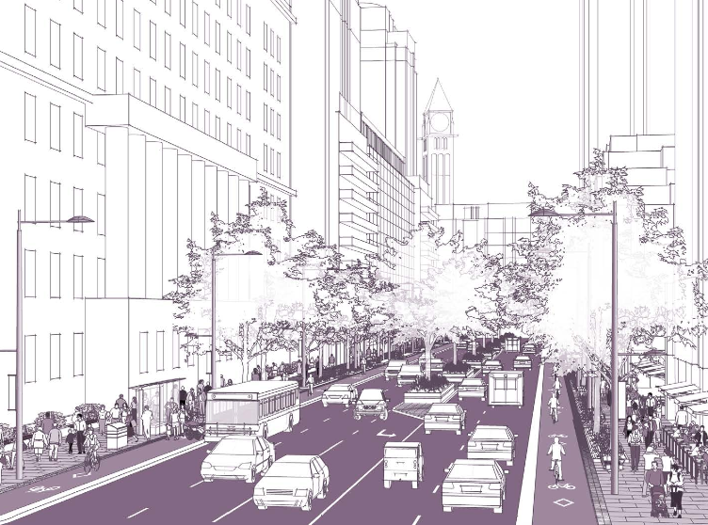
Street Types: The city of Toronto identifies several different street types, each require specific accommodations for their unique traffic patterns
Downtown Commercial
Low-Density Residential
Avenue / Neighborhood Main St.
High Traffic Avenue

Slide 26
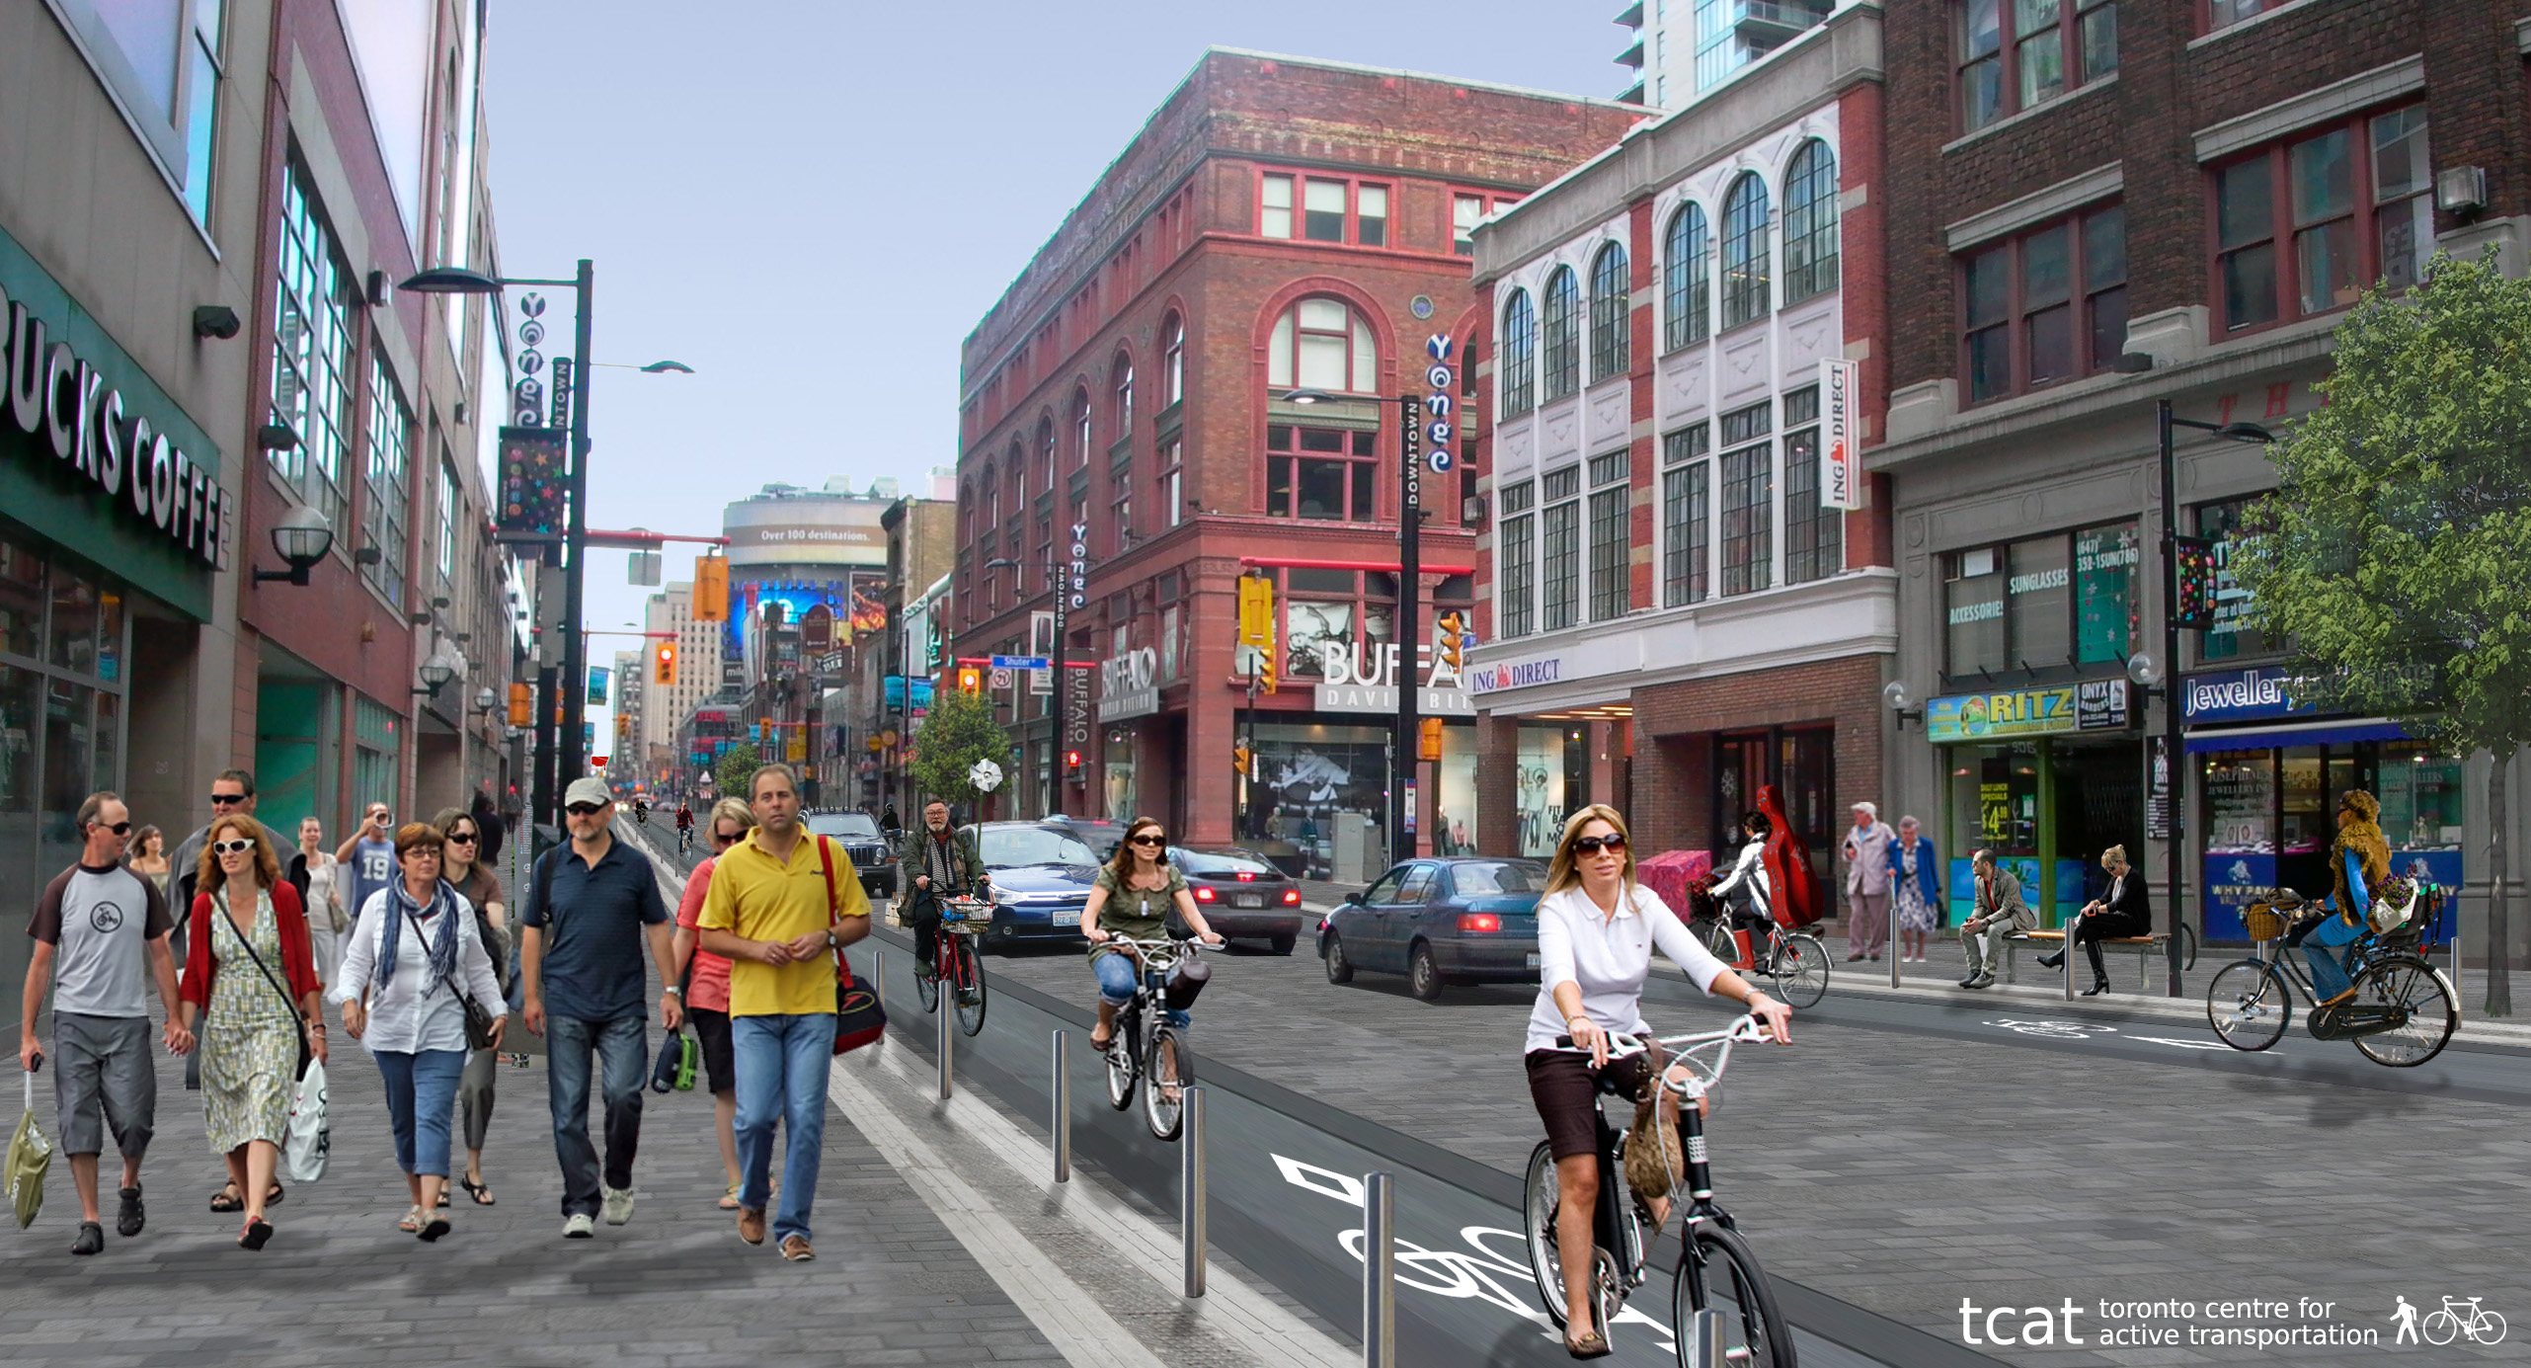

Slide 27
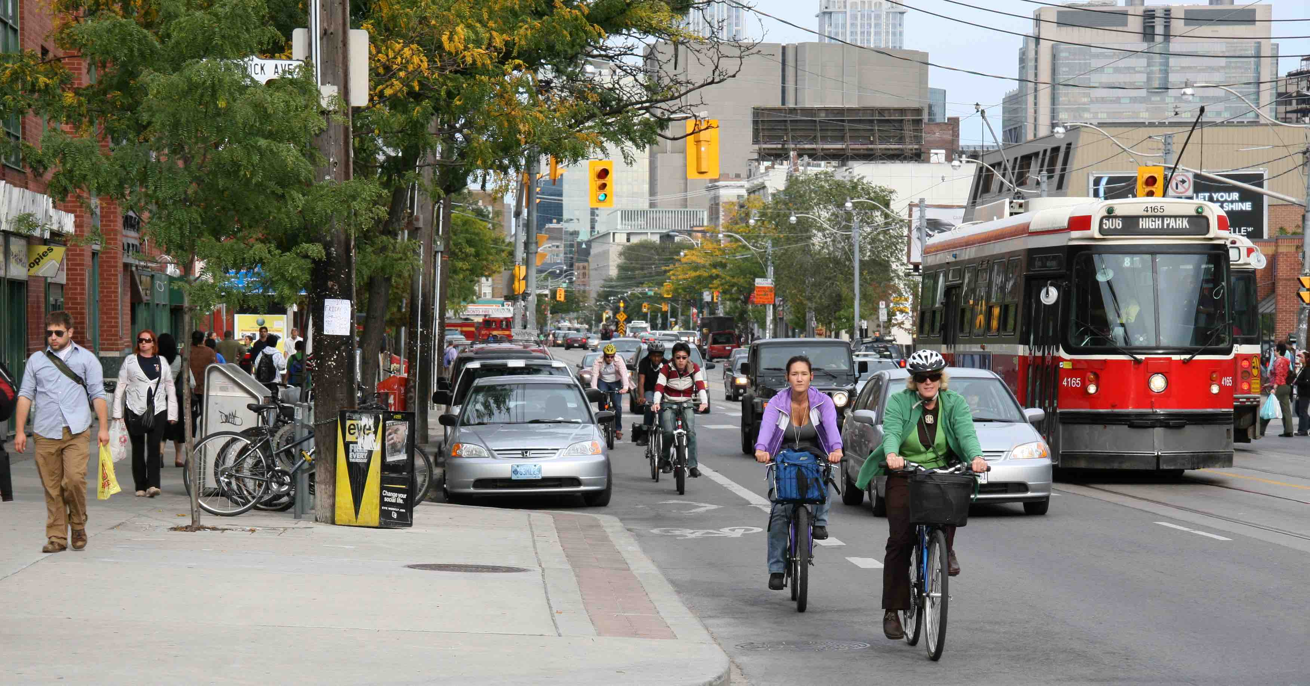

Slide 28
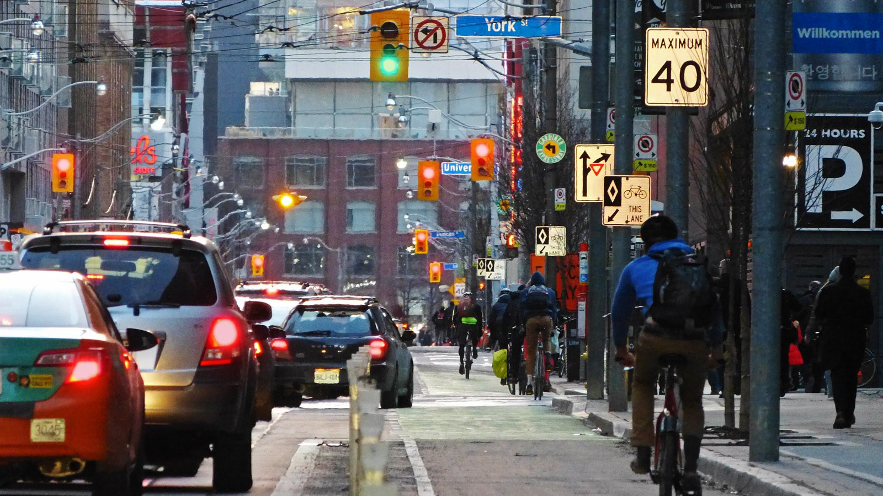

Slide 29
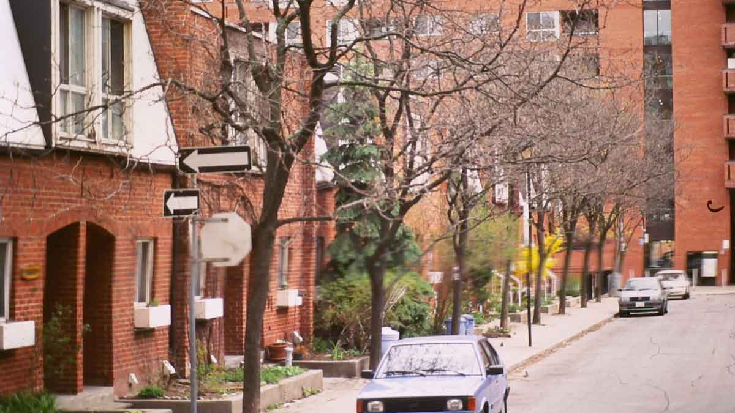

Slide 30
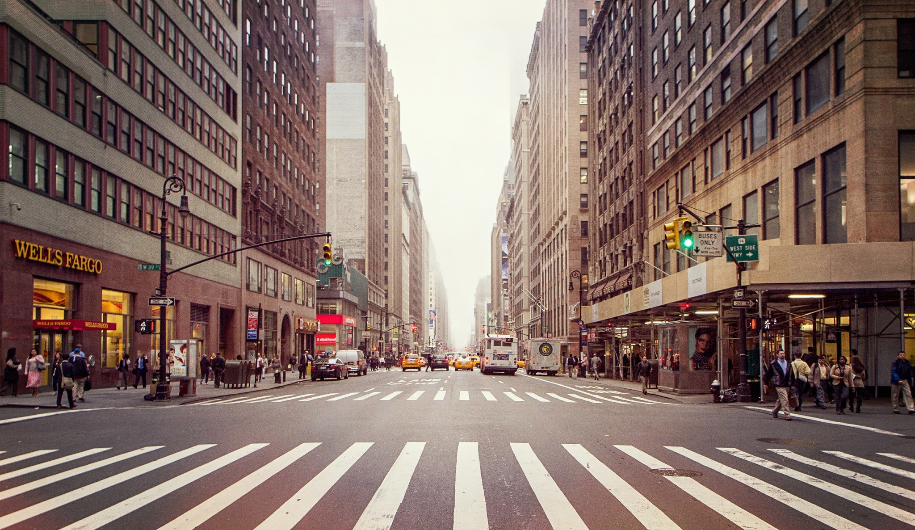
New York’s Complete Streets

Slide 31
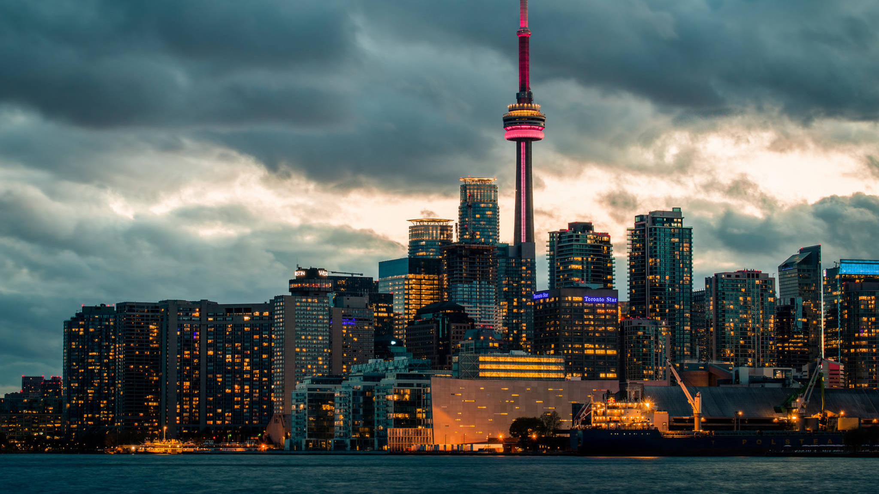
THANK YOU!

